Slide 1
Personal Care
Exercise
Pampering
Home Maintenance
House
Lawn
Car Maintenance
Honda Civic
Kids Activities
Sophie’s Soccer
Jordan’s Karate
Info
Tasks
Lists
Appts
Personal Care
Home Maintenance
Car Maintenance
Kids Activities
Exercise
Cadence: [cadence picker]
People: [people picker]
Organizer
Activity Dashboard
Gallery

Slide 2
Activity Dashboard
Personal Care
Exercise
Haircuts
Home Maintenance
House
Clean Gutters
Lawn
Water Lawn
Mow the Lawn
Car Maintenance
Honda Civic
Change Oil
Renew tabs
Kids Activities
Sophie’s Soccer
Jordan’s Karate
Info
Tasks
Lists
Appts
Personal Care
Home Maintenance
Car Maintenance
Kids Activities
Activity Scheduler
Profile
Exercise
Cadence: [cadence picker]
People: [people picker]
People
Places
Organizer
Activity Editor
Gallery

Slide 3
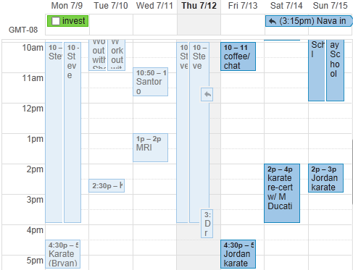
Activity Dashboard
Exercise
Water Lawn
Change Oil
Sophie’s Soccer
Day
Week
Month
Activity Scheduler
Profile
People
Places
Activities
Calendar Viewer

Slide 4
Activity Dashboard
About Me
Connect to Facebook
Calendar Settings
Me
Family
Home Car
Activity Scheduler
Profile
Married?
Spouse: Sheri
Kids:
Jordan
Heather
Sarah-Eve
People
Places
Profile Menu
Profile Editor

